Slide 1
Modeling Autonomous Systems
Giacomo Sfratato, Michele Intrevado, Martina Nolletti

Slide 2
What is an Autonomous System?

Slide 3

What is an Autonomous System?
“An Autonomous System is a system that can change its behavior in response to unanticipated events during operation”^{[1]}
[1] Watson, David P., and David H. Scheidt. "Autonomous systems." Johns Hopkins APL technical digest 26.4 (2005): 368-376.

Slide 4
Differences with Normal Systems

Slide 5
Differences with Normal Systems
The Autonomous System must be able to adapt to situations.
A normal software system relies on a set of Boolean conditions.
[1] Watson, David P., and David H. Scheidt. "Autonomous systems." Johns Hopkins APL technical digest 26.4 (2005): 368-376.

Slide 6
Challenges for modeling Autonomous Systems

Slide 7

Challenges for modeling Autonomous Systems
Use of some approaches is often limited;
Growing complexity of missions and behaviors requests imply the use of complex knowledge;
The system should have an internal model that captures what it knows and learns.
[2] Bocciarelli, Paolo & D'Ambrogio, Andrea & Giglio, Andrea & Paglia, Emiliano. (2015). A Model-driven Framework for Distributed Simulation of Autonomous Systems. 47.

Slide 8
Possible Solutions

Slide 9
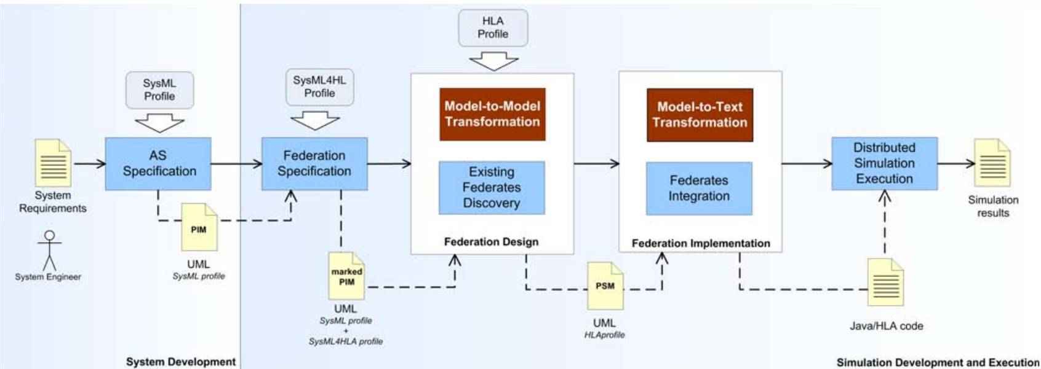
Possible Solutions
[2] Bocciarelli, Paolo & D'Ambrogio, Andrea & Giglio, Andrea & Paglia, Emiliano. (2015). A Model-driven Framework for Distributed Simulation of Autonomous Systems. 47.

Slide 10
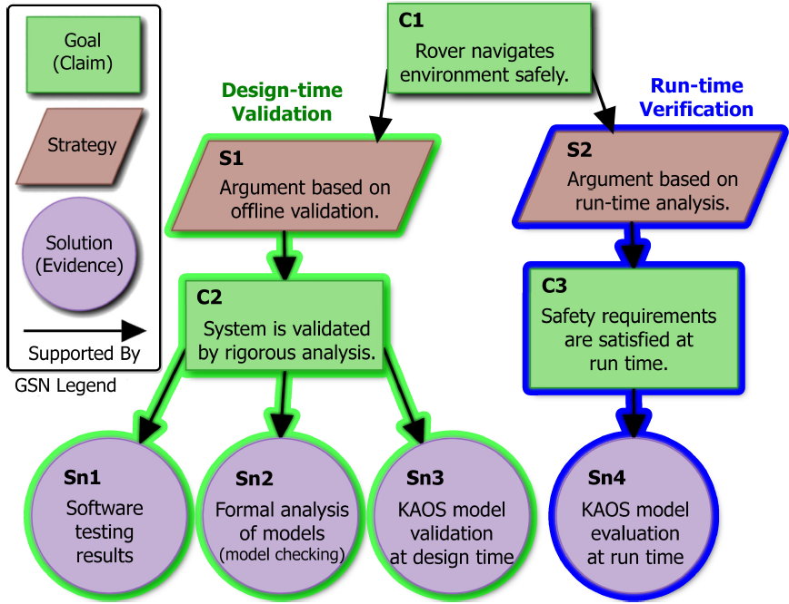
Goal Structuring Notation (GSN)
Goal: it tells how functional and non-functional requirements are met.
Strategy: ways to prove the goal.
Solution: they represent evidences in support of the goal.
[3] M. A. Langford, K. H. Chan, J. E. Fleck, P. K. McKinley and B. H. C. Cheng, "MoDALAS: Model-Driven Assurance for Learning-Enabled Autonomous Systems," 2021 ACM/IEEE 24th International Conference on Model Driven Engineering Languages and Systems (MODELS), 2021, pp. 182-193, doi: 10.1109/MODELS50736.2021.00027.

Slide 11
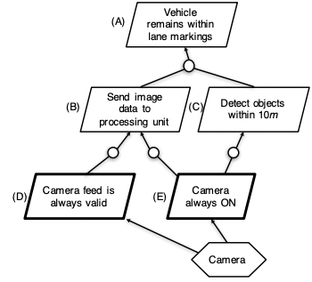
KAOS Goal Modeling Notation
Objects:
Goal
Agent (human or sensor)
Refinement
[4] http://www.cse.msu.edu/~cse870/Lectures/Notes/02c-kaos-goal-modeling-bhc-v3-notes.pdf

Slide 12
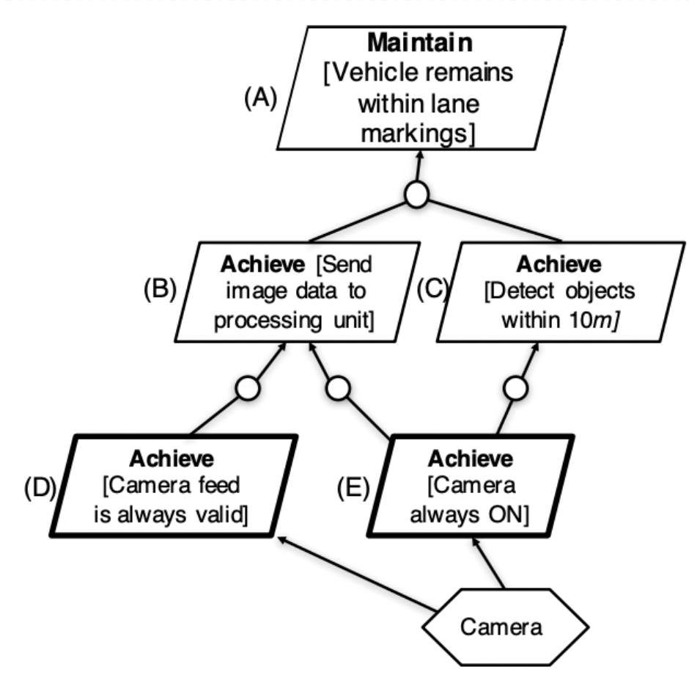
KAOS Goal Modeling Notation
Goal Categories:
Invariant: must ALWAYS be satisfied
Non-invariant: can temporarily be unsatisfied
[4] http://www.cse.msu.edu/~cse870/Lectures/Notes/02c-kaos-goal-modeling-bhc-v3-notes.pdf

Slide 13
KAOS Goal Modeling Notation
Goal Categories:
Invariant: must ALWAYS be satisfied
Non-invariant: can temporarily be unsatisfied
[4] http://www.cse.msu.edu/~cse870/Lectures/Notes/02c-kaos-goal-modeling-bhc-v3-notes.pdf

Slide 14
KAOS Goal Modeling Notation
Objects:
Goal
Agent (human or sensor)
Refinement
[4] http://www.cse.msu.edu/~cse870/Lectures/Notes/02c-kaos-goal-modeling-bhc-v3-notes.pdf

Slide 15
KAOS Goal Modeling Notation
Objects:
Goal
Agent (human or sensor)
Refinement
AND
OR
[4] http://www.cse.msu.edu/~cse870/Lectures/Notes/02c-kaos-goal-modeling-bhc-v3-notes.pdf

Slide 16
Can Learning-Enabled Systems be trusted in safety critical situations?

Slide 17
MoDALAS^{[2]} Framework
The MoDALAS framework enables an LES (AI/ML components) to monitor and evaluate goal models at run time to determine whether or not LECs can be expected to meet functional objectives
Behavior oracles are used to assess the capability of LECs under varying run-time conditions. The resulting self-adaptive LES can then detect when its components are operating outside of performance boundaries and adapt accordingly.
[3] M. A. Langford, K. H. Chan, J. E. Fleck, P. K. McKinley and B. H. C. Cheng, "MoDALAS: Model-Driven Assurance for Learning-Enabled Autonomous Systems," 2021 ACM/IEEE 24th International Conference on Model Driven Engineering Languages and Systems (MODELS), 2021, pp. 182-193, doi: 10.1109/MODELS50736.2021.00027.

Slide 18
How does it work?

Slide 19
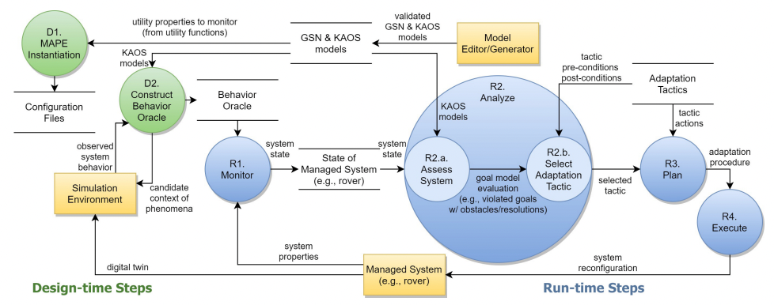
MoDALAS: how it works
[3] M. A. Langford, K. H. Chan, J. E. Fleck, P. K. McKinley and B. H. C. Cheng, "MoDALAS: Model-Driven Assurance for Learning-Enabled Autonomous Systems," 2021 ACM/IEEE 24th International Conference on Model Driven Engineering Languages and Systems (MODELS), 2021, pp. 182-193, doi: 10.1109/MODELS50736.2021.00027.

Slide 20
MoDALAS: how it works
Design Time
Step D1 - MAPE Instantiation Adaption manager (MAPE-K loop) instantiated to manage adaptations, must monitor same system attributes referenced by KAOS goal models.
Step D2 - Construction of Behavior Oracle MoDALAS uses behavior oracles (DNN) to monitor and assess each LEC at run time. Behavior oracles assess the type of LEC behavior to expect under varying run-time conditions.
[3] M. A. Langford, K. H. Chan, J. E. Fleck, P. K. McKinley and B. H. C. Cheng, "MoDALAS: Model-Driven Assurance for Learning-Enabled Autonomous Systems," 2021 ACM/IEEE 24th International Conference on Model Driven Engineering Languages and Systems (MODELS), 2021, pp. 182-193, doi: 10.1109/MODELS50736.2021.00027.

Slide 21
MoDALAS: how it works
Run Time
Step R1 - Monitor Observe and record relevant attributes of the managed LES. Step responsible for observing functional system components as well as behavior oracles for LECs.
Step R2 - Analyze Goal models used to determine if adaptation needed to solve violated requirements. If needed, an adaptation tactic is retrieved from mape-k repository whose preconditions most closely match the current goal model evaluation.
[3] M. A. Langford, K. H. Chan, J. E. Fleck, P. K. McKinley and B. H. C. Cheng, "MoDALAS: Model-Driven Assurance for Learning-Enabled Autonomous Systems," 2021 ACM/IEEE 24th International Conference on Model Driven Engineering Languages and Systems (MODELS), 2021, pp. 182-193, doi: 10.1109/MODELS50736.2021.00027.

Slide 22
MoDALAS: how it works
Run Time
Step R3 - Plan A platform-specific procedure is generated for implementing the actions associated with the selected tactic.
Step R4 - Execute Step R4 is responsible for interfacing with and reconfiguring the managed LES according. Since adaptations may not be safe to perform in all states of the LES, Step R4 must determine safe states where the LES can be reconfigured.
[3] M. A. Langford, K. H. Chan, J. E. Fleck, P. K. McKinley and B. H. C. Cheng, "MoDALAS: Model-Driven Assurance for Learning-Enabled Autonomous Systems," 2021 ACM/IEEE 24th International Conference on Model Driven Engineering Languages and Systems (MODELS), 2021, pp. 182-193, doi: 10.1109/MODELS50736.2021.00027.

Slide 23
Conclusions

Slide 24
Conclusions
We briefly introduced autonomous systems and the key differences with normal software systems.
We learned about KAOS and GSN goal structuring and modeling notations and saw how they can be used in a framework both at design time, to better and more precisely understand what are the system’s goals and requirement, and at run time, so that the system is able to change its behaviour dynamically in order to keep complying with its goals and requirements.
This approach allows to improve the trustworthiness of a learned behavior autonomous system so that it can also be used in a safety critical environment.

Slide 25
